Slide 1
TOPIC A4:
MACHINE LEARNING
LESSON A4-2
MACHINE LEARNING HARDWARE

Slide 2
AGENDA
Warm up
Training and inference
What the hardware has to do
CPUs and GPUs
ASICs and TPUs
FPGAs
Edge devices
Cloud platforms and HPC
Choosing the hardware
WHAT U NEED 4 LESSON
Guided Notes
ur hedz

Slide 3

THE WARM UP QUESTION
(a) State what a label is [1]
(b) State which type of machine learning cannot begin without labelled data [1]
(c) State one kind of task a GPU is better suited to than a CPU [1]
→ Notes Q1 (a), (b), (c)

Slide 4
THE WARM UP ANSWER
(a) The correct answer for an example, attached to it in advance by a person
(b) Supervised learning
(c) Anything made of thousands of identical simple sums that do not depend on each other – Crypto, gaming, rendering, machine learning

Slide 5
TRAINING AND INFERENCE
Today, we’re talking about the hardware needed for machine learning
  There are two different parts to machine learning
    Which part you’re using defines what hardware you need
Training - building the model from the training data.
  Happens once, and it can take hours, days or weeks.
Inference - using the finished model to make a prediction
  Happens constantly, expected to happen quickly
The training process goes over the whole data set over and over, but the inference process is only one input
Your phone did not train its face unlock model. Somebody trained that on a cluster months ago. Your phone only runs it.

Slide 6
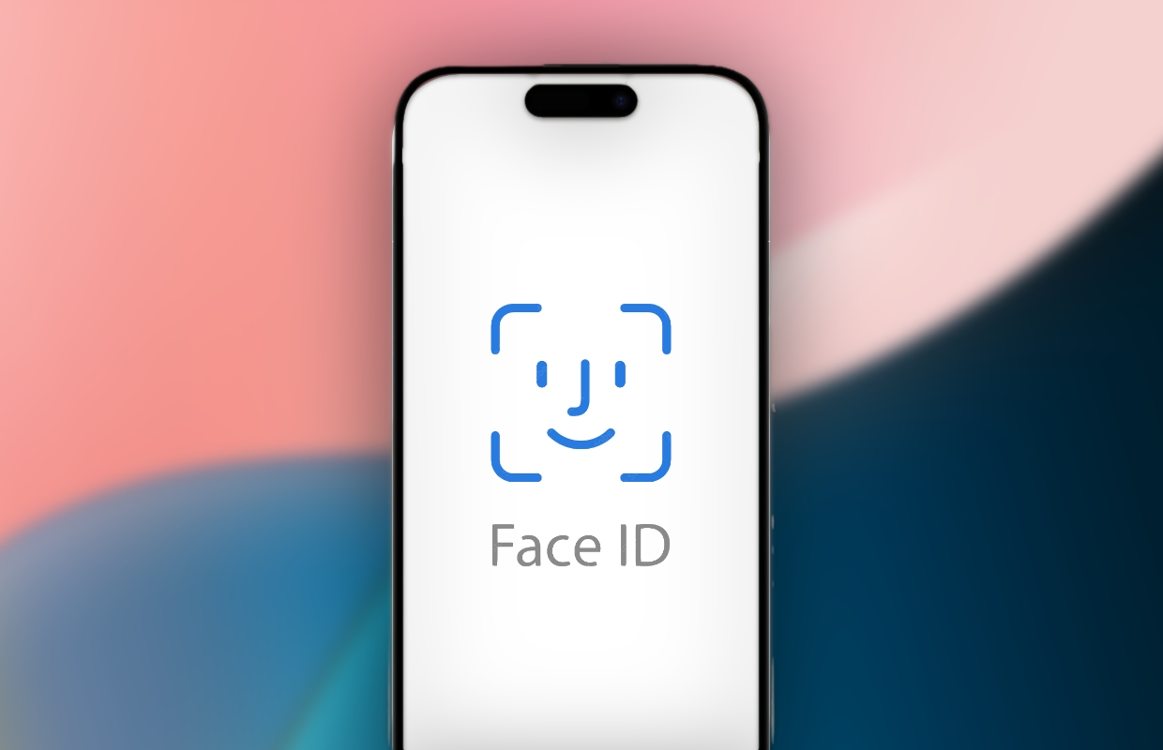
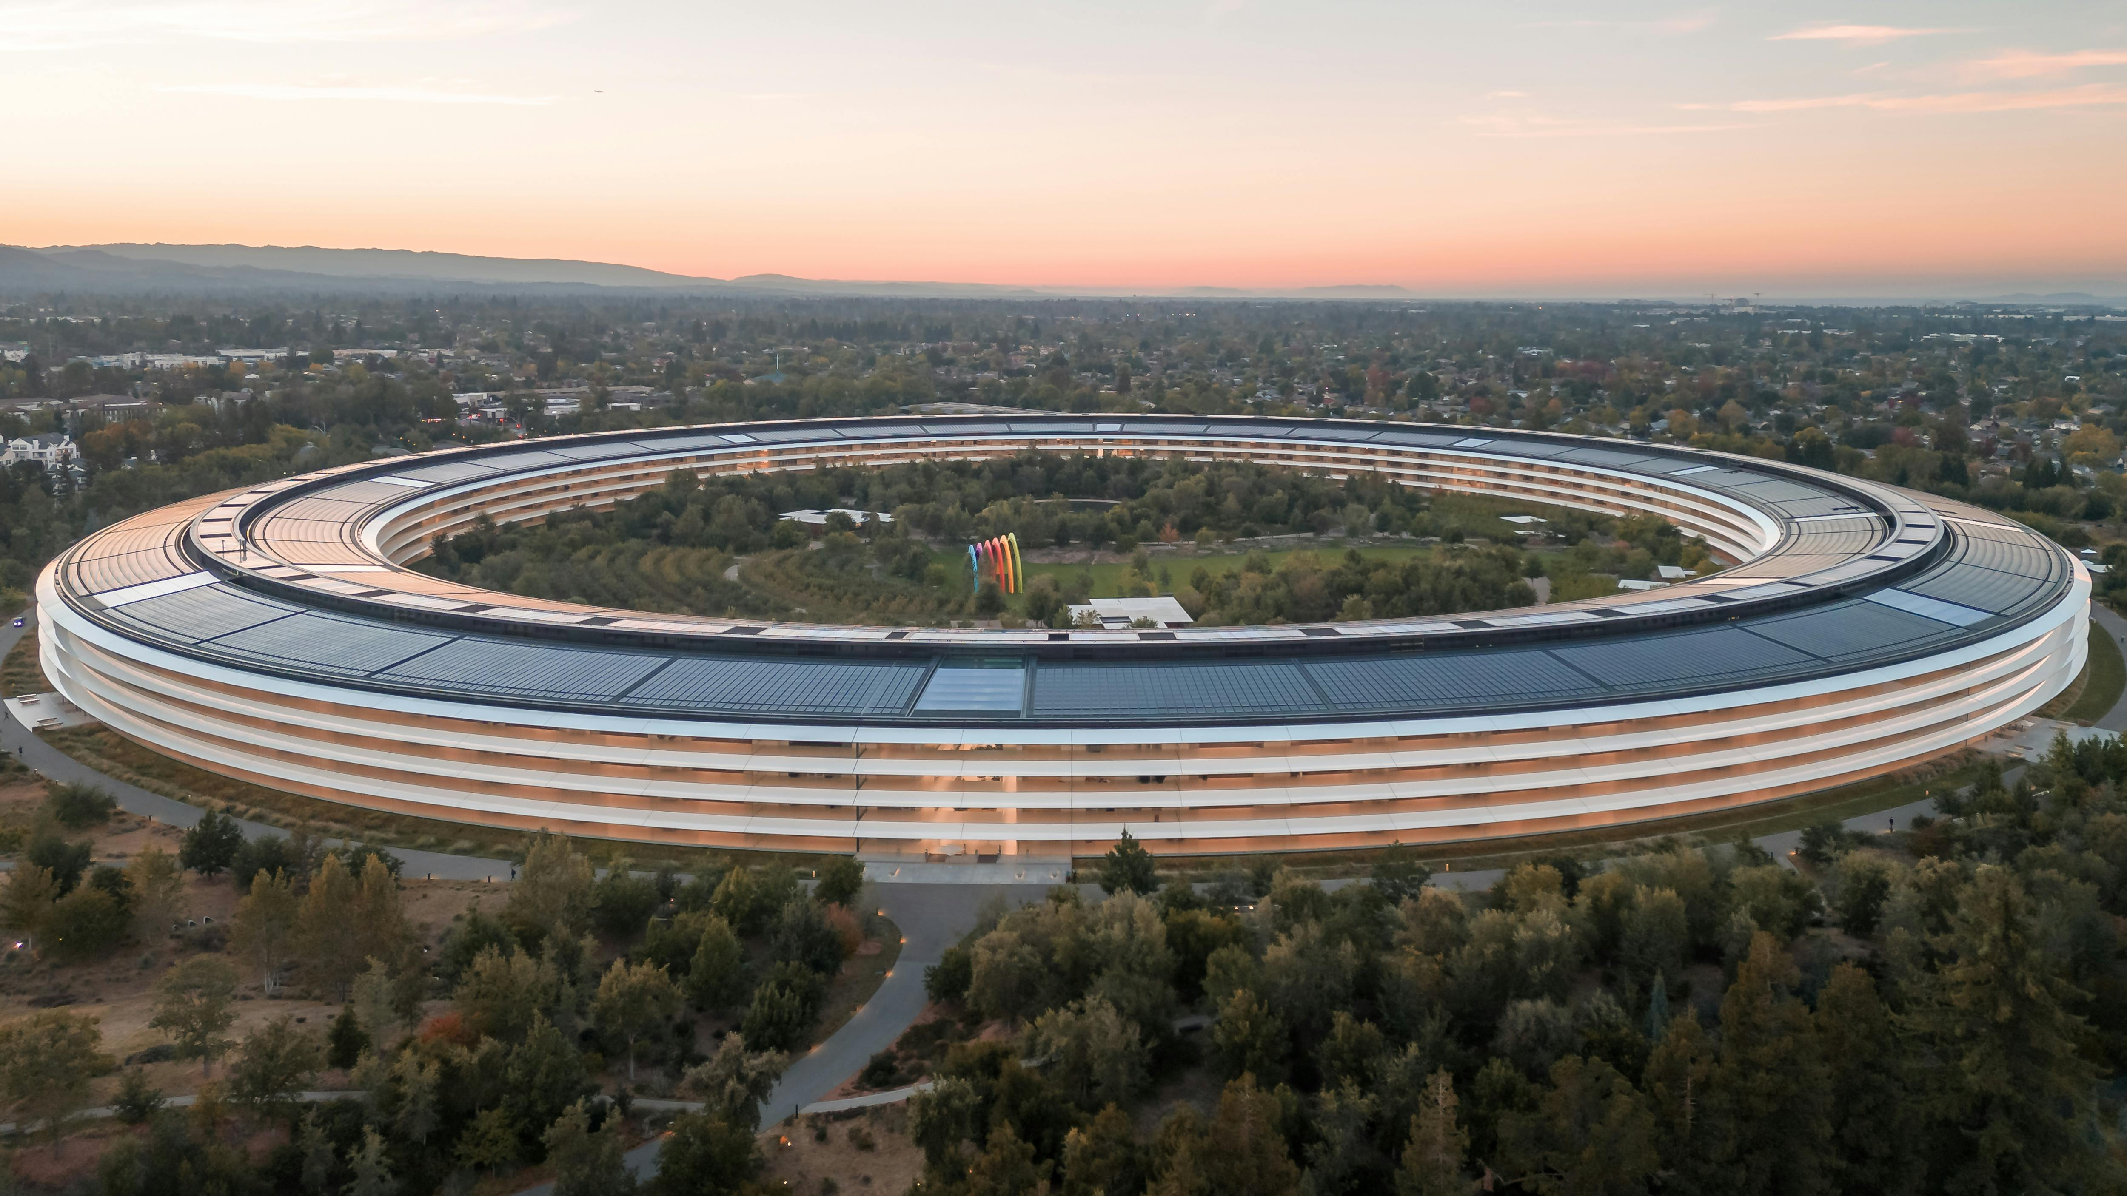
TRAINING AND INFERENCE
FaceID – there is a machine learning model, trained by Apple in Cupertino, in your phone for FaceID
  This training process is NOT handled on your phone, but on Apple servers
  Your phone inferences with your face to set it as the unlocking face, and to unlock the device
Your phone COULD NOT train the FaceID algorithm

Slide 7
TRAINING AND INFERENCE
The same model, two very different jobs
Most questions related to this subject start by deciding if you’re in the training or inference column
→ Notes Q2 (a) and (b)
 | Training | Inference
How often | Once, maybe every few months after | Up to millions of times a day
How long it takes | Hours to weeks | Milliseconds
What it needs | The whole training set | One input
Typical hardware | GPU, TPU, cloud, HPC | Edge device, ASIC, CPU

Slide 8
WHAT THE HARDWARE HAS TO DO
These are the main machine learning metrics according to the IB
Processing - how much arithmetic per second, and how much of it can happen at the same time
  CPU/GPU power
Storage - training sets are measured in terabytes, and they have to be read repeatedly
  RAM/Secondary Storage
  A fast processor that doesn’t have data doesn’t matter
Scalability - can you add more when the job grows? Scaling up means a more powerful single machine; scaling out means adding more machines.
→ Notes Q3

Slide 9
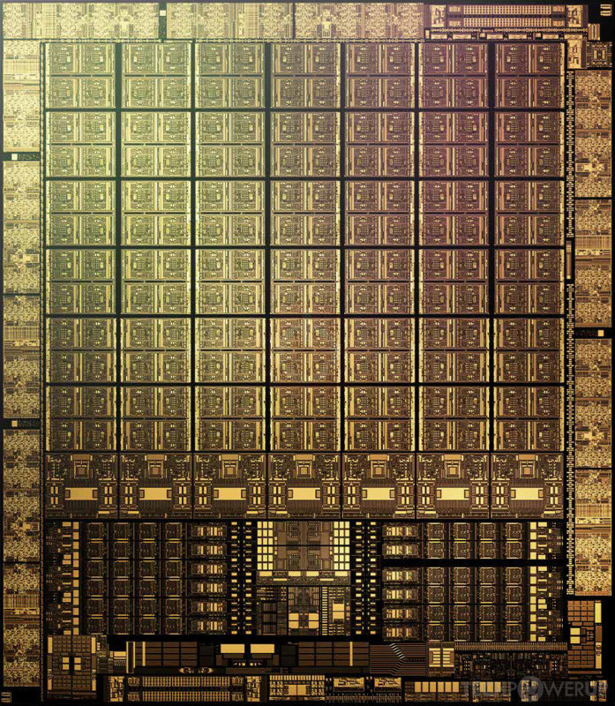
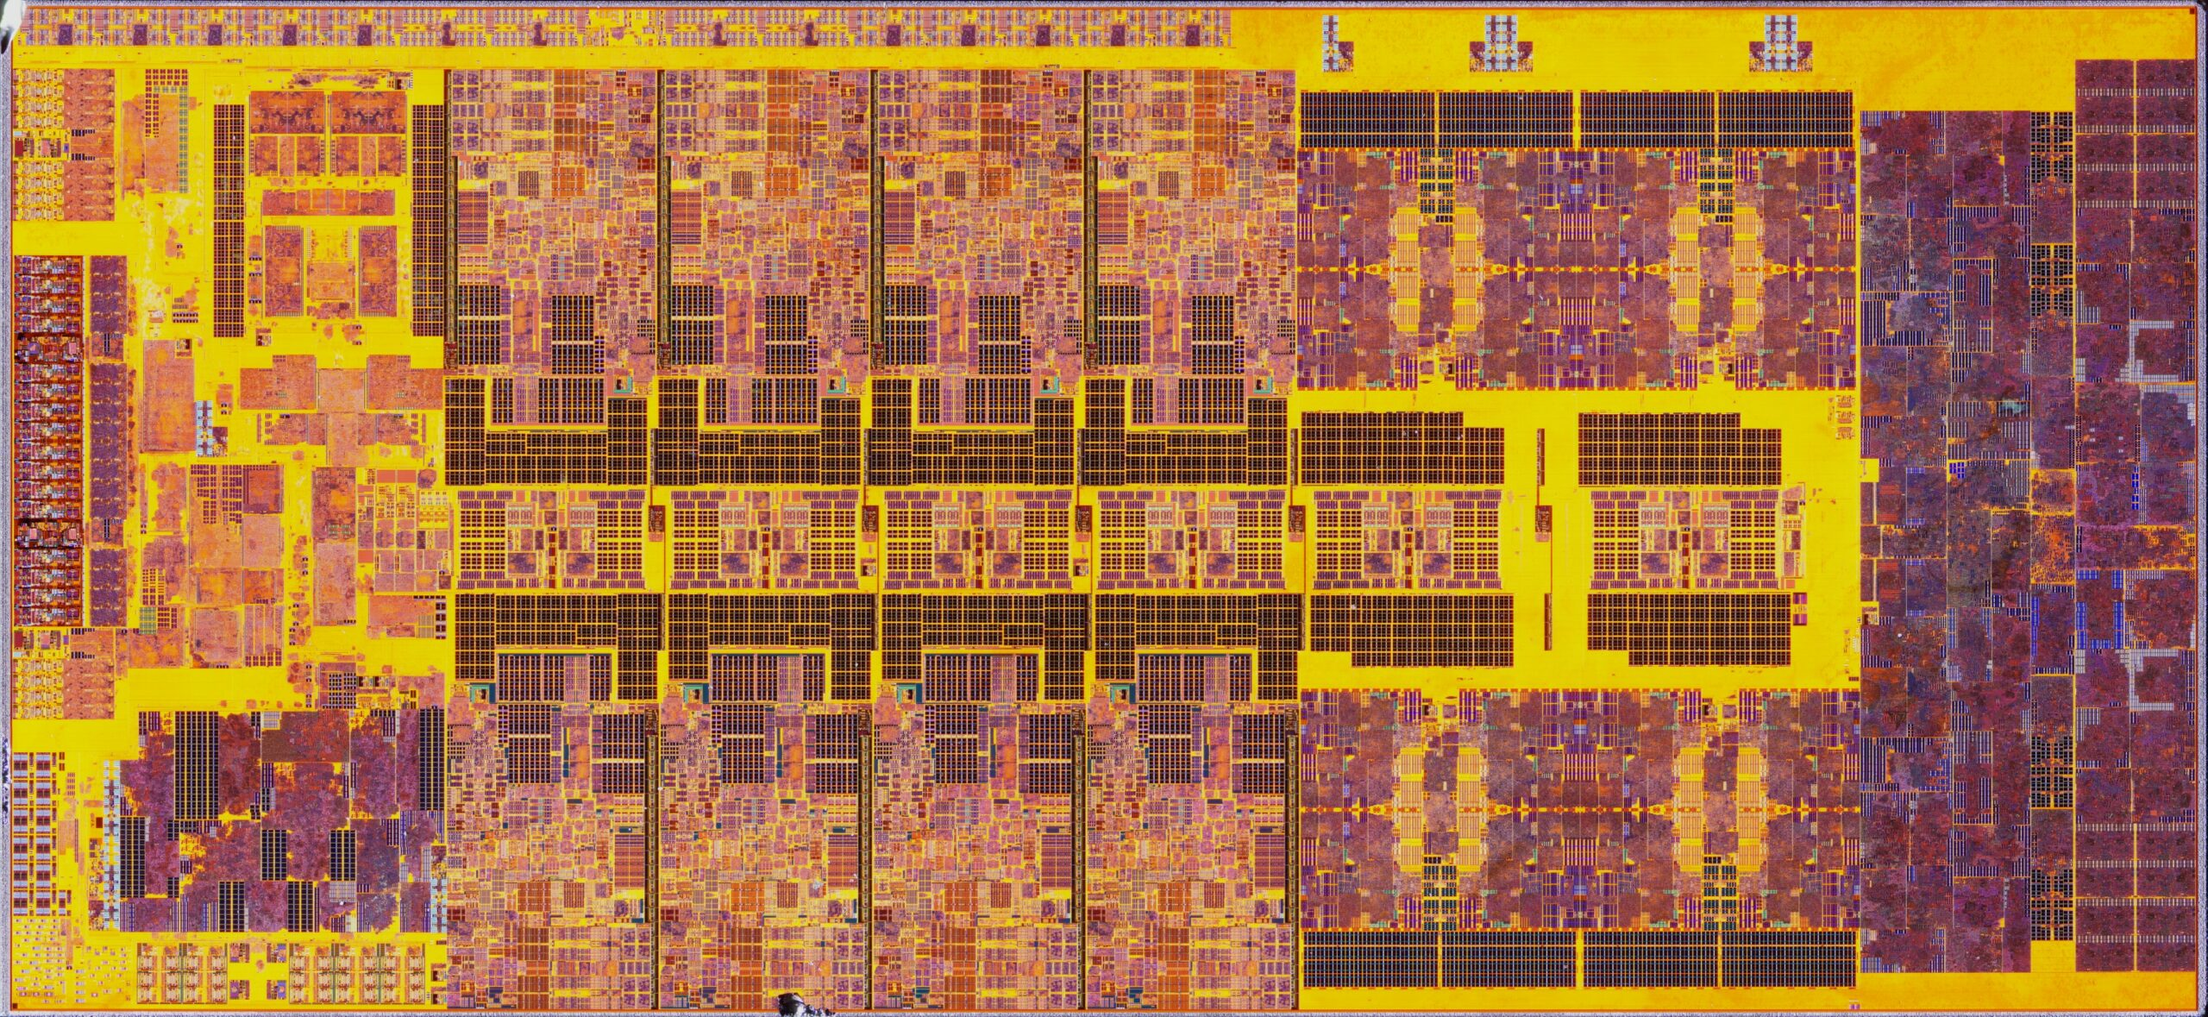
CPUS AND GPUS
CPU - has a few powerful cores
  Very good at sequential, complicated instructions
GPU - has thousands of simple cores,
  Good at repeated, simple instructions
Training consists of millions of multiply-and-add operations that do not depend on each other, so they can all run at once
  Which of these is best for the job?

Slide 10

CPUS AND GPUS
Yeah, this is a GPU’s playhouse, which is why the chip built for video games turned out to be the chip for training models
The CPU is still necessary because it runs the operating system and keeps the GPU fed with data
This is why we can’t afford GPUs

Slide 11
CPUS AND GPUS
→ Notes Q4 (a) and (b)
 | CPU | GPU
Cores | A few, complex | Thousands, simple
Best at | One thing after another | The same thing, many at once
Its job in ML | Running the program, feeding data | The training arithmetic

Slide 12
ASICS AND TPUS
ASIC - application-specific integrated circuit,
  Computer chip manufactured to do exactly one job
Because the circuit is designed to only do one thing, it is extremely fast at that job and uses very little power
  It cannot be changed afterwards, so if a design update is required it will cost millions of dollars in silicon (probably)

Slide 13
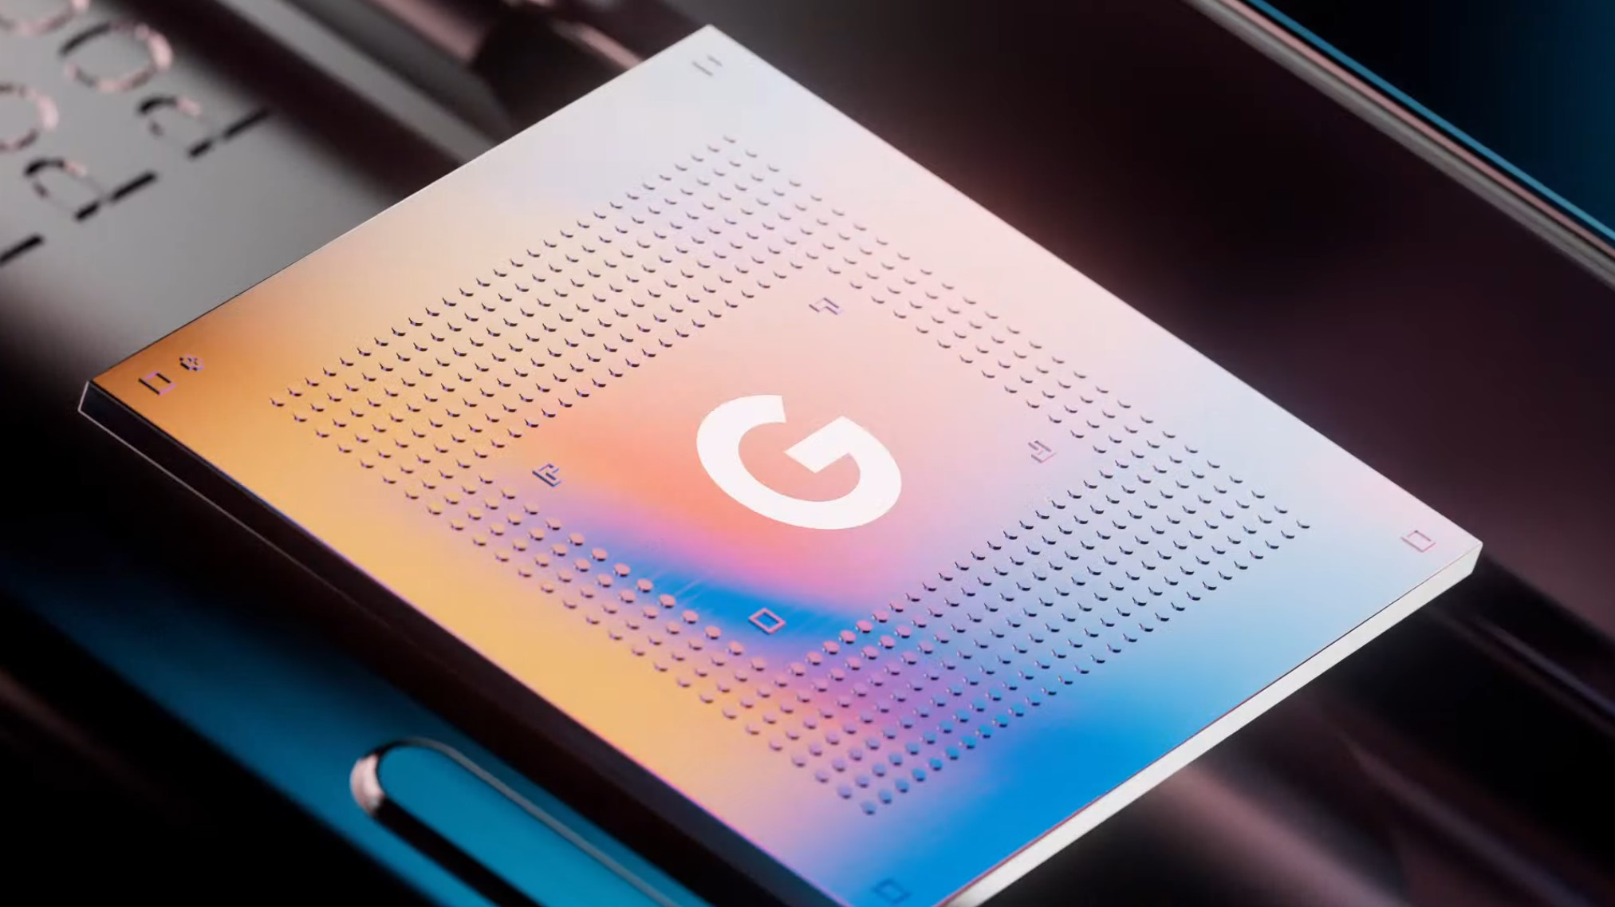
ASICS AND TPUS
TPU - tensor processing unit,
  An ASIC built specifically for the arithmetic that neural networks do
  A TPU is a kind of ASIC, not an alternative to one
  TPUs are created by Google, and other companies now have alternatives
    Pixel phone chips are also custom by Google and called Tensor chips, although those chips are definitely not TPUs, just descended from Google’s ability to create them
The only reason you’d ever get a chip like this is if you knew you’d be running it billions of times,
  In a lot of cases, companies will still just buy GPUs from Nvidia

Slide 14
FPGAS
FPGA - field-programmable gate array,
  A chip whose logic gates can be rewired after it has been manufactured
  Do not ask me how this works lol
  Slower and less power-efficient than an ASIC doing the same job
  You can reprogram it when the model changes, unlike an ASIC
Used for prototyping, for small production runs, and anywhere the design changes a lot
An ASIC is fixed and fast, an FPGA is changeable and slower
→ Notes Q5 (a), (b) and (c)

Slide 15
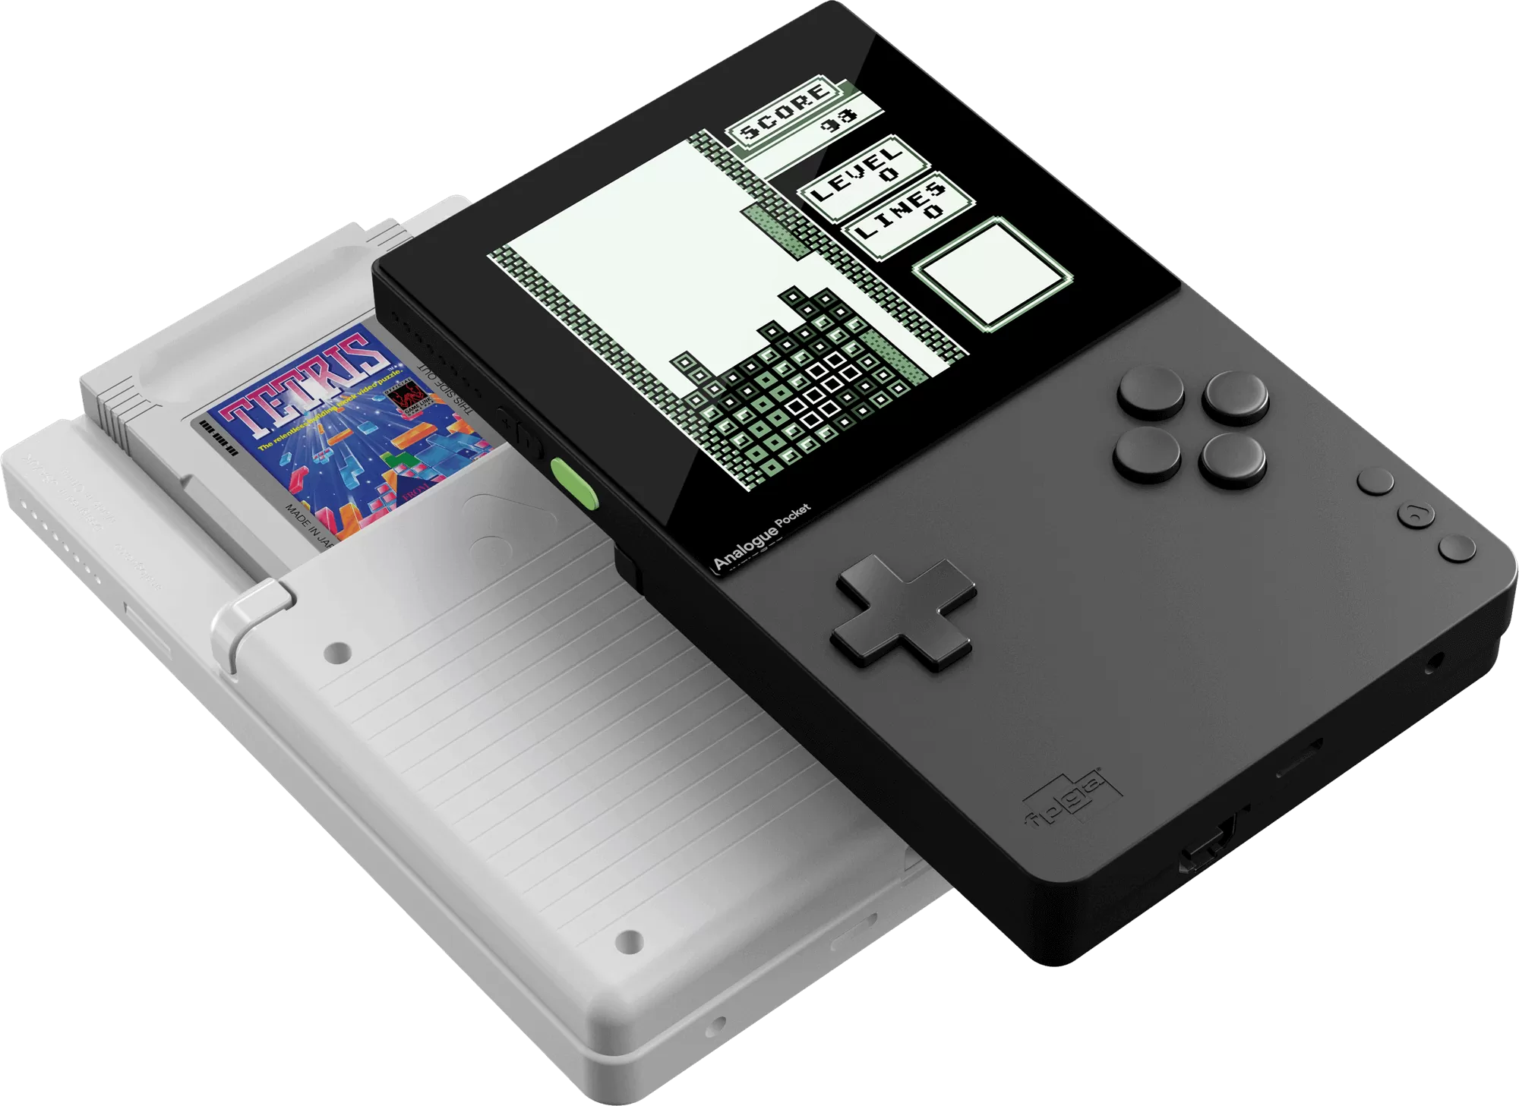
FPGAS
Cool FPGA tangent:
  This is an Analogue Pocket
  It’s capable of playing retro games from the
    GameBoy, GameBoy Color, GameBody Advance, Sega Game Gear, and Atari Lynx
    Using original cartridges!
      How?
        It uses an FPGA chip that re-architects itself to mimic the original system’s chip perfectly
          Meaning that you can play these games without emulation!

Slide 16
EDGE DEVICES
An edge device runs a machine learning model on the device itself
  Such as a phone, a camera, a car, etc.
Data is never sent over the internet, so no delay is present
The data also never leaves the device, making it more private
  It keeps working when the network does not
Tight limits on power, memory and heat,
  The model must be small enough to run on that device
Unlocking a phone with your face is inference on an edge device: the model is already on the phone, and the photo never leave the phone
→ Notes Q6 (a) and (b)

Slide 17
CLOUD PLATFORMS AND HPC
A cloud platform rents you the hardware instead of selling it to you
  You can take a hundred GPUs for one afternoon and then give them back
    This means that cloud platforms are very good for scaling out
This is IaaS if you manage the machines yourself, PaaS if you just bring the model
An HPC center (High Performance Compute Center) is a cluster of machines wired together for the very largest training runs
  Universities and national laboratories run these, and you queue for time on them
    UTD has one: https://hpc.utdallas.edu/

Slide 18
CLOUD PLATFORMS AND HPC
Owning the training hardware
  Expensive up front, cheap per hour after that
  Sits idly by if you aren’t currently training
Renting the training hardwre
  Costs nothing up front, expensive if you train constantly
  Your data is on somebody else’s hardware
It’s another COMPUTER SCIENCE TRADEOFF WOAH
→ Notes Q7 (a) and (b)

Slide 19
CHOOSING THE HARDWARE
The syllabus range runs from a standard laptop to advanced infrastructure
Both ends are right answers, for different jobs
The scenario | Training or inference? | Sensible hardware
A student trains a model on 2,000 rows | Training | A standard laptop
A hospital trains on 500,000 scans | Training | Cloud GPUs or an HPC cluster
A doorbell recognises a face | Inference | An edge device
One fixed model, run billions of times | Inference | An ASIC
A team is still changing the design | Either | An FPGA
Notes:
Row one and row four are both correct. The best hardware depends on the job, not on which chip is most powerful.

Slide 20
CHOOSING THE HARDWARE
To decide, ask yourself these three questions
1: is this training or inference?
2: how much data has to be read, and how often?
3: does it have to be instant, private, or work offline?
Then justify it using processing, storage and scalability
→ Notes Q8

Slide 21
QUIZ
Quiz A4-1 — Topic A4.1, 13 marks, 15 minutes
Covers lesson A4-1 and today: the three types of machine learning, training data and labels, and hardware
Notes away, laptops away

Slide 22

VOCABULARY TO REMEMBER
Training
Inference
Processing
Storage
Scalability
Scaling up
Scaling out
CPU
GPU
ASIC
TPU
FPGA
Edge device
Cloud platform
IaaS
PaaS
HPC centre
Latency

